Slide 1
Introduction to Music Appreciation
Kenny Lim

Slide 2
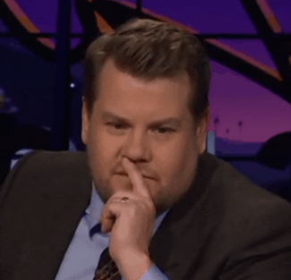
What is Music Appreciation?
Notes:
- Importance of music: Music plays an important role in our life, anyone of you go party? You need music; when you’re stuck in traffic jams in KL, you listen to radio; you play games and watch movies? Soundtrack plays a huge role in setting moods for them. In short, music has become something that we encounter every single day, but how much do we know about them?
- In the old days, before recording equipment was invented, if you want to listen to music, you either 1) perform it yourself or 2) travel to a concert hall. Recording equipment changed how music can be consumed today.
- Q: Who went to an orchestral concert before?
- Q: What do you feel when attending a concert there?
- Attending a live concert, doesn’t matter if it’s a classical or pop concert, it provides a live experience that you cannot get from listening to recording, and also live performance provides more musical liveliness. (In my opinion)

Slide 3
Why would you want to listen to classical music?
Helps them to relax.
Helps us center the mind, allowing the listener to concentrate.
Classical music provides a vision of a better world.
Notes:
Survey from american national public radio

Slide 4


Kahoot.it OR

Slide 5
Elements of Music
Q: What is sound?
A: “Sound begins with the vibration of an object.”
Pitch
Dynamics
Tone color
Duration (Rhythm)
Notes:
- So today we will be talking about Elements of music, anyone knows what does elements mean?
- ELEMENT: (Noun) An essential or characteristic part of something abstract.
- Music is an abstract art, you cannot see it, touch it; but you know it’s there, why?
- So when we are listening to music, what properties do we listen to?
- “Music is part of this world of sound, an art based on the organization of sounds in time. We distinguish music from other sounds by recognizing the four main properties of musical sounds: Pitch, dynamics (loudness or softness), tone color, and duration.”

Slide 6
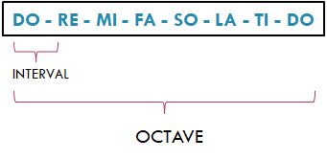
Pitch
• Pitch is the relative highness or lowness we hear in a sound.
• The pitch of a sound is determined by the frequency of its vibration.
• A definite pitch is called a TONE
Notes:
- The first properties we will be looking at today is Pitch.
- Pitch is the relative highness or lowness we hear in a sound, in western music pitch are separated in to 7 main pitches, can anyone tell me what these pitch are? Or sing them.
- Great, so the pitch of a sound is determined by the frequency of its vibration.
- (Demonstrate using twirl pipe)
- In music, a definite pitch is called a Tone. Which means when the frequency is consistent it will produce a pitch, so if a sound has an inconsistent frequency, it will not produce a consistent tone.

Slide 7
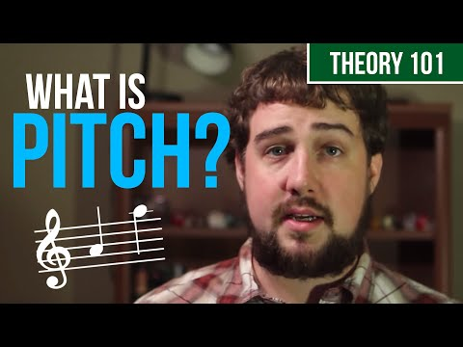

Slide 8
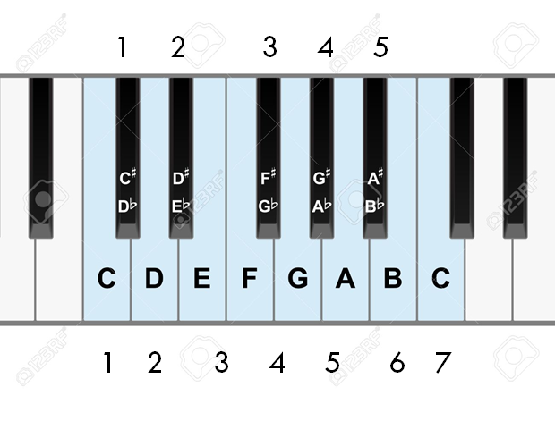
Notes:
- In western music pitch are separated in to 7 main tones, can anyone tell me what these tones are? Or sing them.
- Great, now when we talk about the distance between each tone we call them intervals, but when we talk about the distance between the same low and higher tone, we call them intervals.
#sing doremi

Slide 9
Learn to sing the pitches!
5. SO
4. FA
3. MI
2. RE
1. DO
8. DO’
7. TI
6. LA
5. SO
4. FA
3. MI
2. RE
1. DO

Slide 10
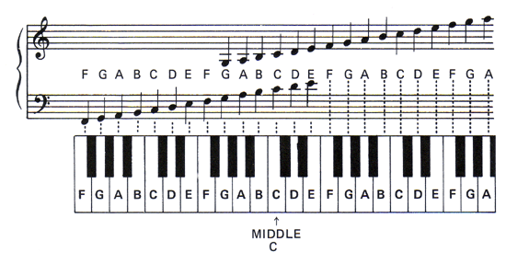
Notes on the keyboard

Slide 11
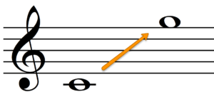
Pitch range/ Range
The distance between the lowest and highest tones that a voice or instrument can produce.
E.G. Piano’s range is over 7 octaves; an average untrained voice is between 1 and 2 octaves.
Soprano voice range:

Slide 12
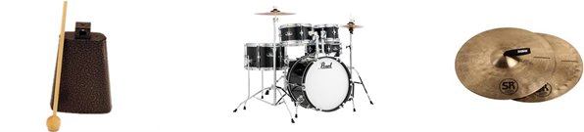
Indefinite Pitches in Music
Drums, percussions
Plays important role in contemporary western music and in musical cultures around the world
http://tegrity.columbiabasin.edu/classes/MUS115RP/Pitch_Lesson_2_10/Pitch_Lesson_2_105.html

Slide 13
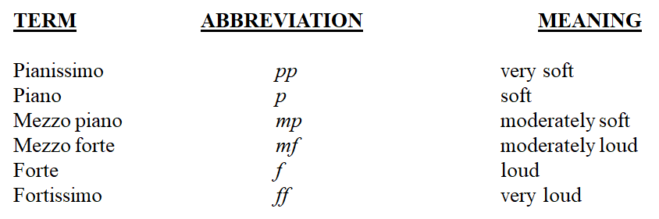
Dynamics
Degree of Loudness or Softness in music.

Slide 14
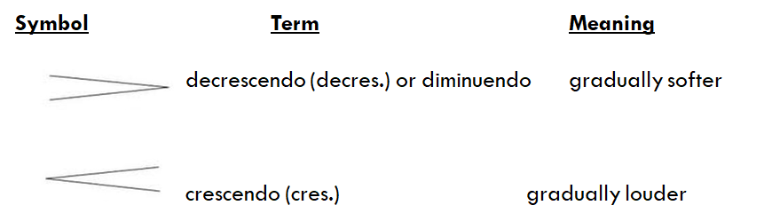
Dynamic symbols

Slide 15
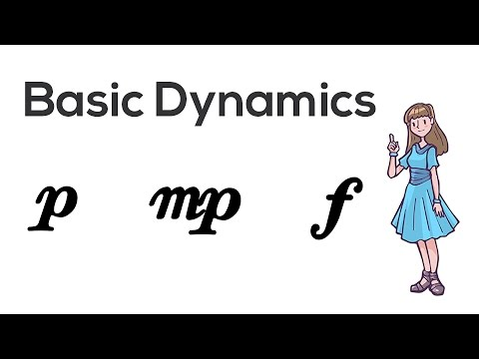

Slide 16
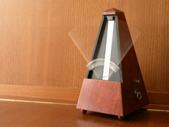
Rhythm
“In music, rhythm refers to the ordered durations of sounds and silences.”
BEAT
METER
ACCENT AND SYNCOPATION
TEMPO

Slide 17
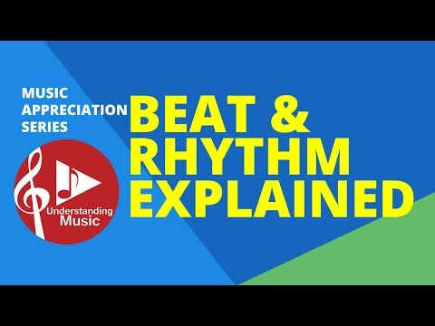
BEAT & RHYTHM

Slide 18
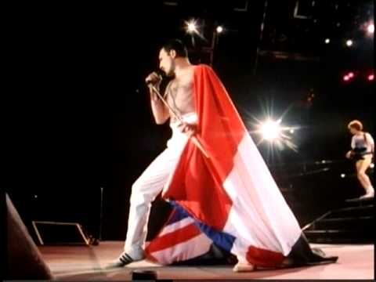
BEAT & RHYTHM
Beats are the consistent pulse throughout a piece of music.
Rhythm are the ordered flow of melody through time.

Slide 19
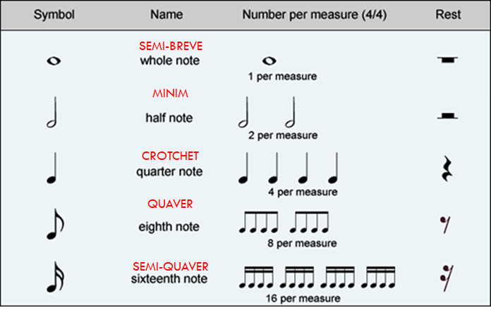
Note values & Rests
Notes:
Practice singing rhythm using hand gestures

Slide 20


Learn the rhythms
1.
TA
2.
TA TI

Slide 21


3.
4.
TA TA KA TA KA

Slide 22


5.
6.

Slide 23
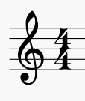

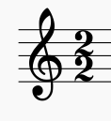




Time Signatures
OR
Four Quarter Beats in a Bar
OR
Alla-breve: 2 Half Beats in a Bar
Questions:

Slide 24
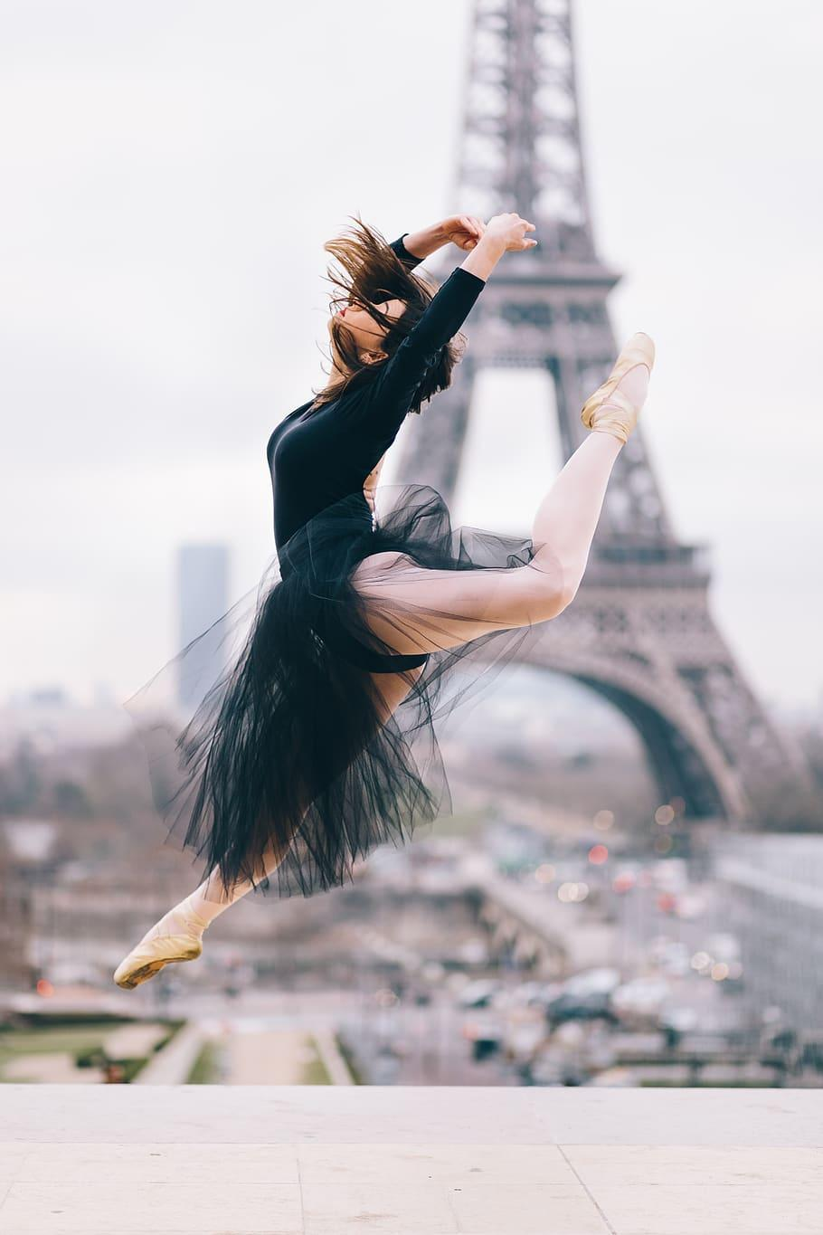
Meter
“A repeated pattern of strong beats plus one or more weaker beats.”
Types of Meter:
Duple Meter
Tripler Meter
Quadruple Meter
Quintuple Meter
Sextuple Meter
Septuple Meter

Slide 25
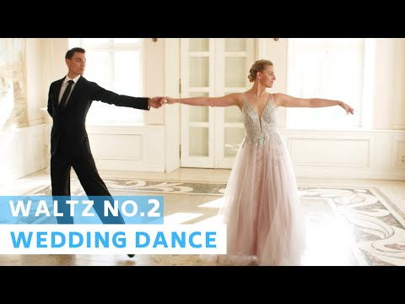

Slide 26
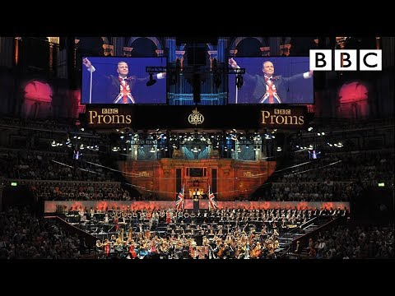

Slide 27
Accent and Syncopation
Accent is a type of dynamic
when an accented note comes where we normally would not expect one, the effect is known as syncopation
“offbeat”
Syncopation is a characteristic feature of jazz

Slide 28
Syncopated Rhythms
Rhythm that are stressed or accented on where the beats don’t normally occur.

Slide 29
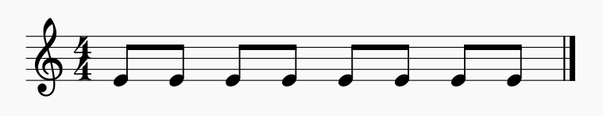
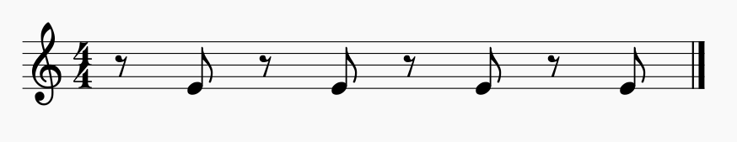
A
B

Slide 30
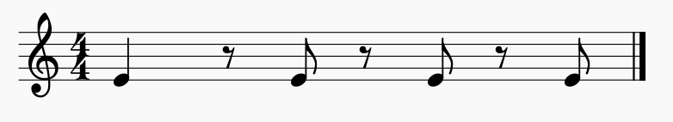
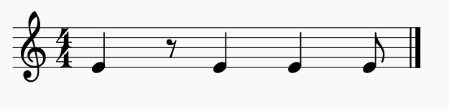
C
D

Slide 31
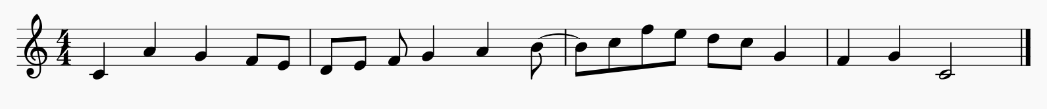

Syncopated Melody

Slide 32
Tempo
Term | Meaning
Largo | Very slow, broad
Grave | Very slow, solemn
Adagio | Moderately slow, a walking pace
Moderato | Moderate
Allegretto | Moderately fast
Allegro | Fast
Vivace | Lively
Presto | Very fast
Prestissimo | As fast as possible
Speed of the Beat
A tempo indication is usually given at the beginning of a piece of music.

Slide 33
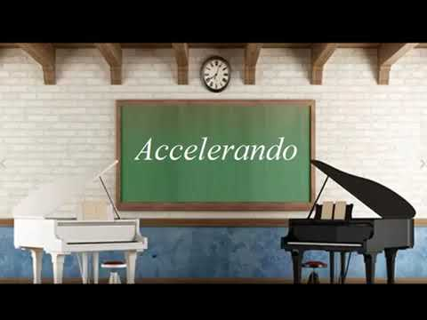
Accelerando & Ritardando
Accelerando (Accel…)
Beat getting faster
Ritardando (Rit…)
Beat getting slower

Slide 34
Break

Slide 35
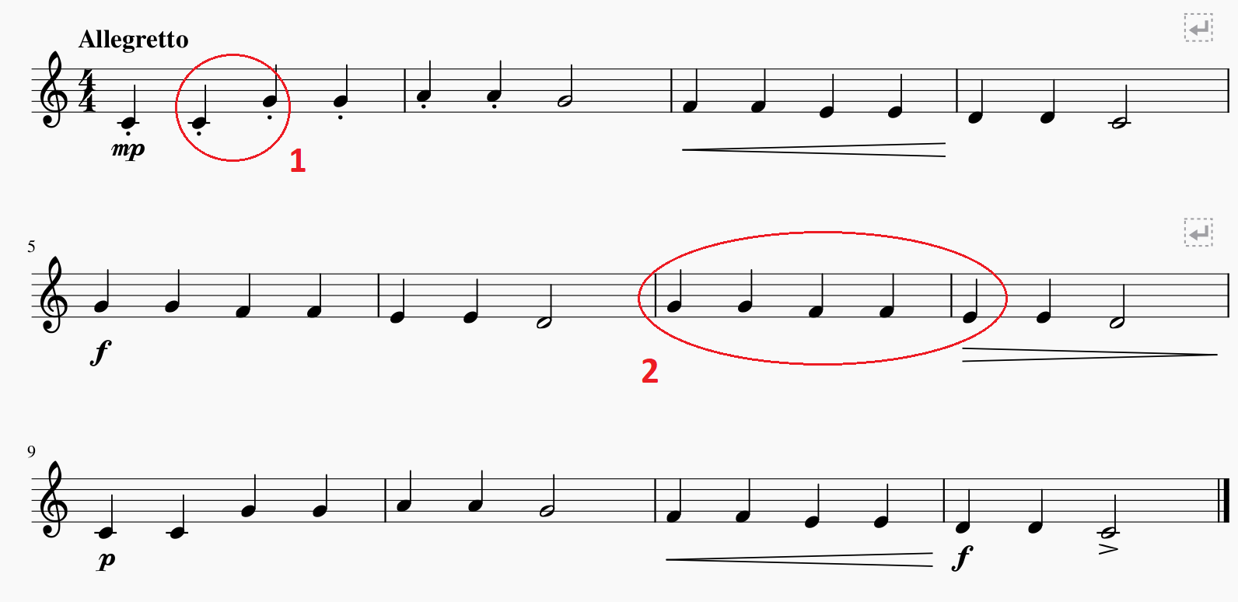
Let’s do some “analysis”!

Slide 36
Tone Color
•The quality to distinguish different tones of different instrument is called tone color, OR timbre (pronounced tam’-ber)
•Tone color is described by words such as bright, dark, brilliant, mellow, and rich.
•Listening*
•Wagner Longherin (disc1, no.1)
•Stravinsky firebird (disc1, no.8)

Slide 37

Theme
The musical material on which part or all of a work is based, usually having a recognizable melody and sometimes perceivable as a complete musical expression in itself, independent of the work to which it belongs. – grove music online
Theme can be recognizable through melody or rhythm

